Slide 1
Fuzzy-Cuts: A Knowledge-Driven Graph-Based Method for Medical Image Segmentation
Deepak Roy Chittajallu
Advisor: Prof. Ioannis A. Kakadiaris
Computational Biomedicine Lab
University of Houston

Slide 2
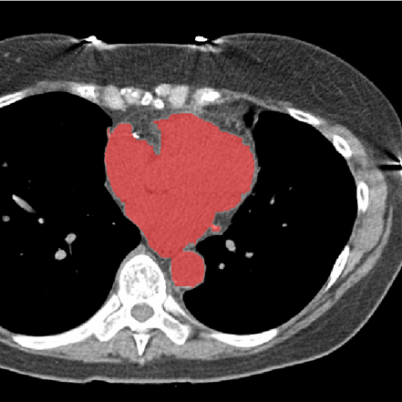
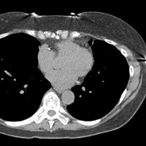
Motivation
Image segmentation is an ill-posed problem
Additional constraints need to be imposed to achieve the desired results
Fortunately, in the field of medical image segmentation a significant amount of prior knowledge is available
Non-contrast CT scan
Prior Knowledge
?
Heart

Slide 3
Motivation
Image segmentation is an ill-posed problem
Additional constraints need to be imposed to achieve the desired results
Fortunately, in the field of medical image segmentation a significant amount of prior knowledge is available
Non-contrast CT scan
Prior Knowledge
Heart
Appearance
and
Spatial Connectivity Prior

Slide 4


Motivation
Image segmentation is an ill-posed problem
Additional constraints need to be imposed to achieve the desired results
Fortunately, in the field of medical image segmentation a significant amount of prior knowledge is available
Non-contrast CT scan
Prior Knowledge
Heart
Inner Thoracic Region
Location Prior

Slide 5
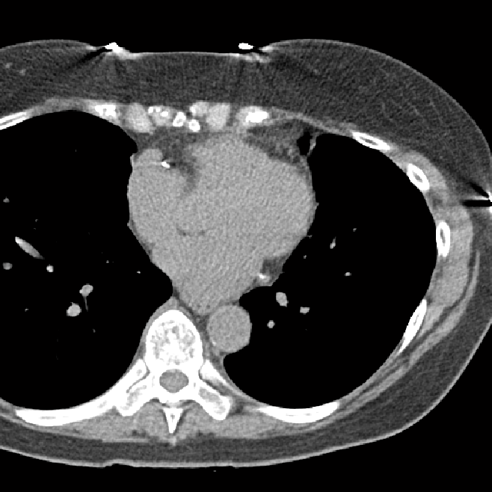



Motivation
Image segmentation is an ill-posed problem
Additional constraints need to be imposed to achieve the desired results
Fortunately, in the field of medical image segmentation a significant amount of prior knowledge is available
Non-contrast CT scan
Prior Knowledge
Heart
Location Prior

Slide 6


Motivation
Image segmentation is an ill-posed problem
Additional constraints need to be imposed to achieve the desired results
Fortunately, in the field of medical image segmentation a significant amount of prior knowledge is available
However, it is difficult to unify various types of prior information available such as appearance, location and shape into a single framework
Non-contrast CT scan
Prior Knowledge
Heart

Slide 7
Objective
Using prior knowledge to constrain the solution space of the Image Segmentation problem
Here, we focus on three types of prior knowledge:
Location
Appearance
Spatial connectivity to a known seed region
Our Approach
We propose a fuzzy theoretic model to incorporate knowledge-driven constrains into the MAP-MRF formulation of the segmentation problem

Slide 8
Image Segmentation
“find a mapping that minimizes an energy functional conditioned over the observed image data D, where P is the set of pixels and L is the set of labels.”
We cast the segmentation problem as a MAP-MRF problem
The MAP-MRF solution can be computed by minimizing the following Gibbs energy function:
First-order Clique Potential
Second-order Clique Potential

Slide 9
Definition of First-order Clique Potential -
measures the cost of assigning label to pixel given prior knowledge about the data D
We define as a spatial fuzzy set defined on the image space S as shown below:
Fuzzy Connectivity Prior
Fuzzy Location Prior

Slide 10

Fuzzy Connectivity Prior -
We use fuzzy connectedness proposed by Udupa et. al. to model
Fuzzy connectedness models the following notion:
“if two regions have about the same appearance and if they are spatially connected to each other in the image space then they most likely belong to the same object”
R1
R2
J. K. Udupa and S. Samarasekera. Fuzzy connectedness and object definition: Theory, algorithms, and applications in image
segmentation. Graphical Models and Image Processing, 58(3):246–261, 1996.

Slide 11
Fuzzy Connectivity Prior - …
R1
R3
R2

Slide 12
Fuzzy Connectivity Prior - …
P1
P2

Slide 13
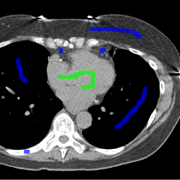
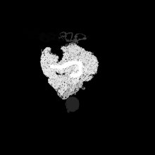
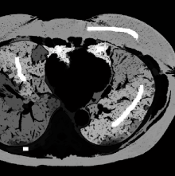
Fuzzy Connectivity Prior - …
We define as a spatial fuzzy set representing a fuzzy connected component of object given a seed region R of the object as shown below:
is the fuzzy affinity function representing the affinity between two neighboring pixels
and as shown below:
Adjacency Test
Similarity in Appearance

Slide 14
Fuzzy Location Prior -
is a spatial fuzzy set representing the likelihood that object is located at pixel given prior knowledge about the location of the object
An organ’s location is specified in terms of its spatial relationship with neighboring organs
For example, anatomically the heart is located:
“inside” the thoracic cavity
“between” the lungs

Slide 15



Fuzzy Location Prior - …
In such a scenario, we model as a fuzzy conjunction of its spatial relationship with each of the neighboring organs as shown below:
A variety of ways to model fuzzy spatial relationships such as “inside”, “outside”, “left of”, “right of” etc. are available in literature (see Bloch et. al. )
If segmentation of neighboring objects is not available, we can define using a probabilistic atlas obtained after performing atlas registration
Spatial relationship with neighboring object K

Slide 16
Definition of Second-order clique potential -
measures the cost of jointly assigning a label to pixel and a label to its neighboring pixel given any prior knowledge about the data D
We define based on a Generalized Potts Interaction model* as shown below:
where and are feature vectors of pixels and respectively
is the covariance matrix
* Y. Boykov and G. Funka-Lea. Graph cuts and efficient N-D image segmentation. International Journal of Computer Vision, 70(2):109–131, 2006.

Slide 17
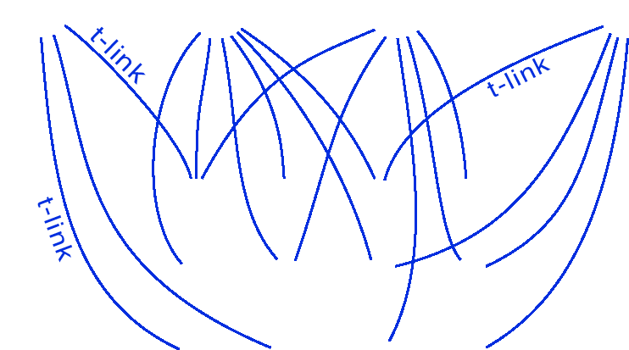
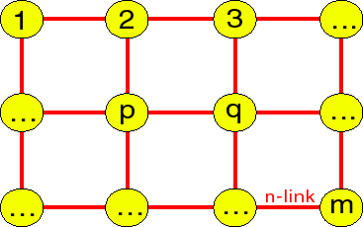


Minimizing Gibbs Energy using Graph-Cuts
edge | weight (cost) | for
n-link -
t-link -
Minimizing is equivalent to find the minimum cost multi-way cut on the above graph
For L = {0,1}, a global minimum can be obtained in polynomial time by solving the s-t minimum cut problem
For |L| > 2, the optimal multi-way cut problem is NP-Hard

Slide 18






Experiments: Heart Segmentation
Fuzzy Location Priors
Foreground
Background
Fuzzy Connectivity Priors
Foreground
Background

Slide 19


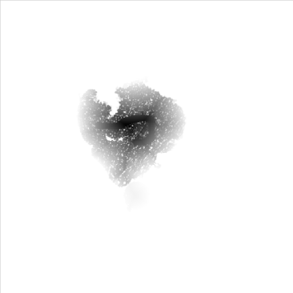
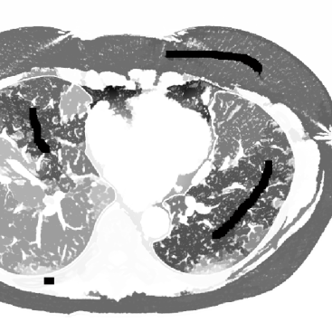
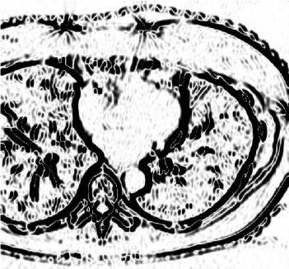
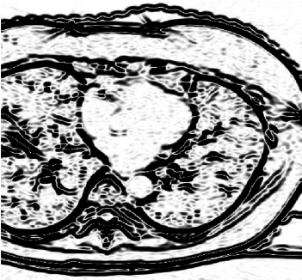
Experiments: Heart Segmentation …
First-order clique potentials
Foreground
Background
Foreground
Background
Fuzzy Location Prior
Foreground
Background
Fuzzy Connectivity Prior
Second-order clique potentials
Segmentation Result
X-Dir
Y-Dir

Slide 20
Conclusion
Fuzzy theoretic approach to incorporate prior knowledge into the MAP-MRF formulation
How to incorporate prior knowledge about an object’s
“Location”
“Appearance and spatial connectivity to a known seed region”
Future work will focus on the incorporation of shape priors into the proposed framework

Slide 21
References
D.R. Chittajallu, G. Brunner, U. Kurkure, R.P. Yalamanchili, and I. A. Kakadiaris, "Fuzzy-cuts: A knowledge-driven graph-based method for medical image segmentation," in Proc. IEEE Computer Society Conference on Computer Vision and Pattern Recognition, Miami Beach, FL, June 20-25, 2009.
S. Z. Li, Markov random field modeling in computer vision: Springer-Verlag, 1995.
J. K. Udupa and S. Samarasekera, "Fuzzy connectedness and object definition: Theory, algorithms, and applications in image segmentation," Graphical Models and Image Processing, vol. 58, pp. 246-261, 1996.
Y. Boykov, O. Veksler, and R. Zabih, "Fast approximate energy minimization via graph cuts," IEEE Transactions on Pattern Analysis and Machine Intelligence, vol. 23, pp. 1222-1239, 2001.
Y. Boykov and G. Funka-Lea, "Graph cuts and efficient N-D image segmentation," International Journal of Computer Vision, vol. 70, pp. 109-131, 2006.
I. Bloch, "Fuzzy spatial relationships for image processing and interpretation: A review," Image and Vision Computing, vol. 23, pp. 89-110, 2005.

Slide 22
Acknowledgements
Advisor: Prof. Ioannis A. Kakadiaris
CBL Lab Members
Dr. Gerd Brunner
Dr. Uday Kurkure
Raja Yalamanchili
This work was supported in part by NSF Grants IIS-0431144 and CNS-0521527 and the UH Eckhard Pfeiffer Endowment Fund.

Slide 23
Questions
?

Slide 24
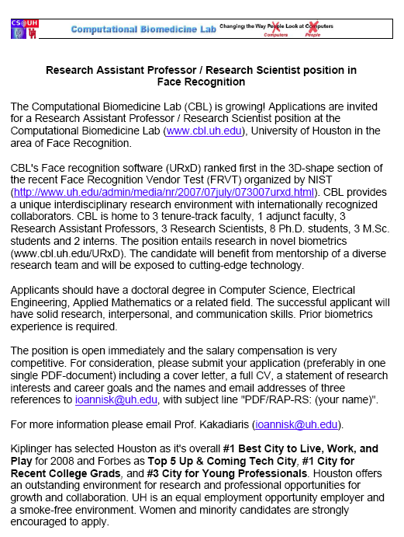
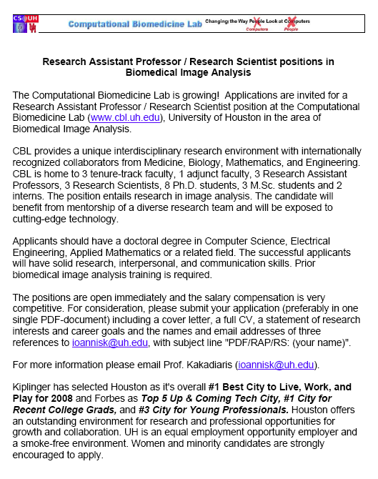
Openings

